Slide 1

Advancing Harmful Algal Bloom Management with the CE-QUAL-W2 Water Quality Model
UNCLASSIFIED
Todd E. Steissberg, PhD, PE
Environmental Laboratory
Engineer Research and Development Center (ERDC)
U.S. Army Corps of Engineers
Co-PIs: Dr. Jodi Ryder, Dr. Emily Summers, Dr. Hailie Suk, and Mr. Isaac Mudge
EPA Water Modeling Forum
December 2, 2025
UNCLASSIFIED

Slide 2
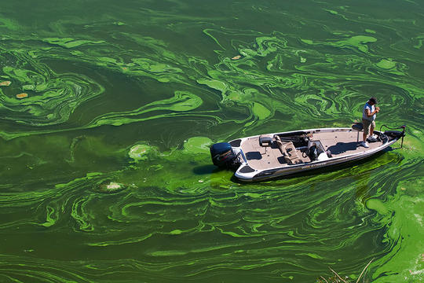
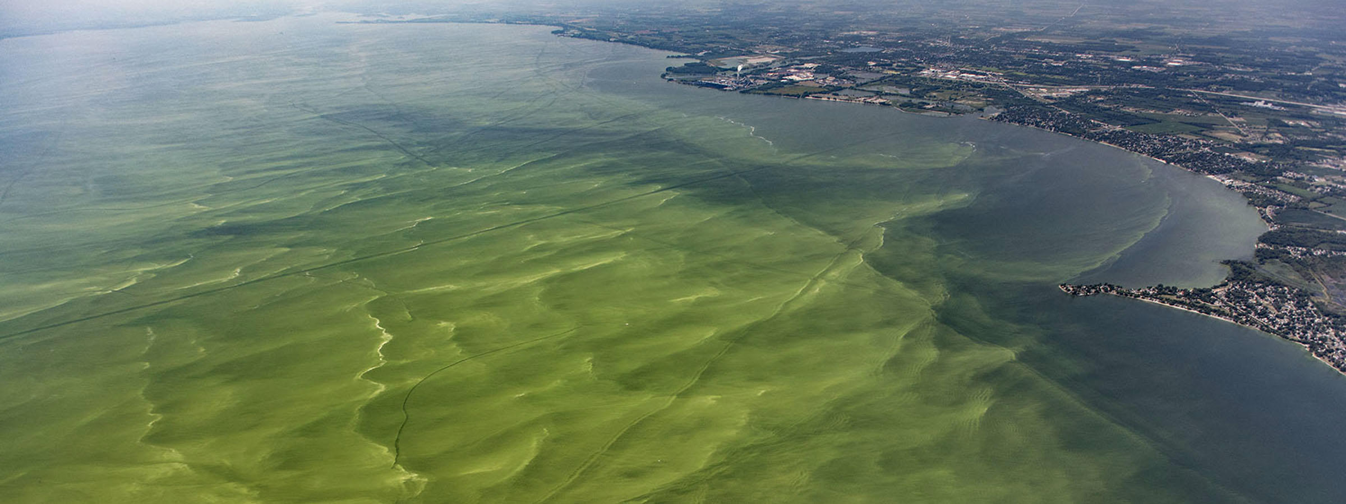
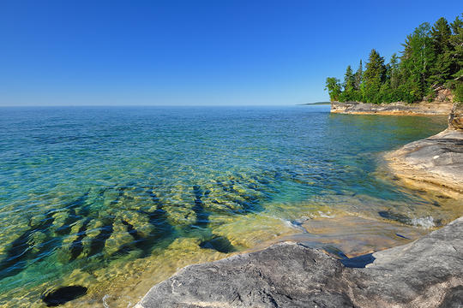
Introduction
Problem: Existing models inadequately predict the timing, frequency, intensity, spatial variability, and impacts of Harmful Algal Blooms (HABs).
Solution: New capabilities have been added to CE-QUAL-W2 to improve its ability to simulate and manage HABs.

Slide 3

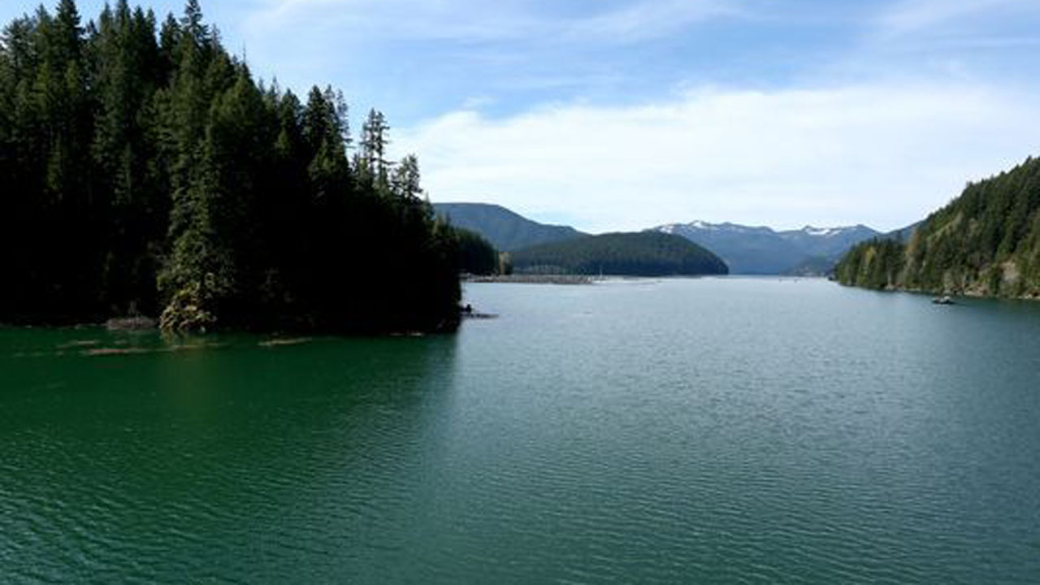
Challenges and Solutions
Predicting HABs is very challenging. Reservoirs have characteristics that can vary significantly:
Algal species
Diurnal vertical migration of some species of cyanobacteria
Volume
Depth
Mixing dynamics (wind forcing and fetch)
Water body morphometry (length, width, shape)
Harmful algal blooms can exhibit rapid changes and non-linear dynamics that are difficult to capture in model simulations.
To address these issues:
Extensive literature review. Feedback gathered from HAB experts.
Case study site (Detroit Lake, Oregon) was selected to provide adequate data and a range of conditions that enables development of scaling methods.
Single species selected for algorithm development.
Detroit Lake, Oregon
Detroit Lake HAB

Slide 4

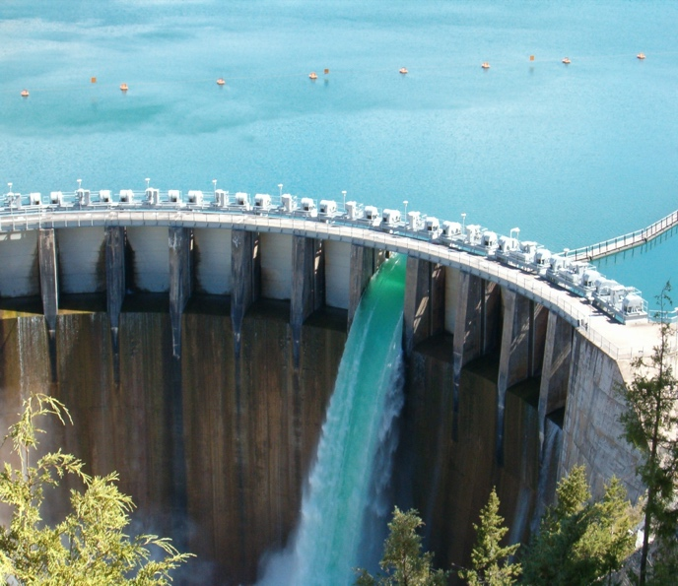
CE-QUAL-W2
CE‐QUAL‐W2 is a two‐dimensional (2D), longitudinal/vertical, hydrodynamics and water quality model. It enables characterization of the vertical and longitudinal changes in a reservoir. The model assumes the reservoir is “well mixed” laterally, with no variation from one side of the channel to each layer (vertical) and segment (longitudinal).
CE-QUAL-W2 has been applied to rivers, lakes, reservoirs, estuaries, and combinations thereof.
CE-QUAL-W2 incorporates the following water quality capabilities:
Longitudinal-vertical hydrodynamics and water quality in stratified and non-stratified systems
Nutrients-dissolved oxygen-organic matter interactions
Fish habitat
Selective withdrawal from stratified reservoir outlets
Hypolimnetic aeration
Multiple algae, epiphyton/periphyton, zooplankton, and macrophytes
CBOD
Sediment diagenesis model
Generic water quality groups
Internal dynamic pipe/culvert model
Hydraulic structures (weirs, spillways) algorithms, including a dynamic shading algorithm based on topographic and vegetative cover.

Slide 5
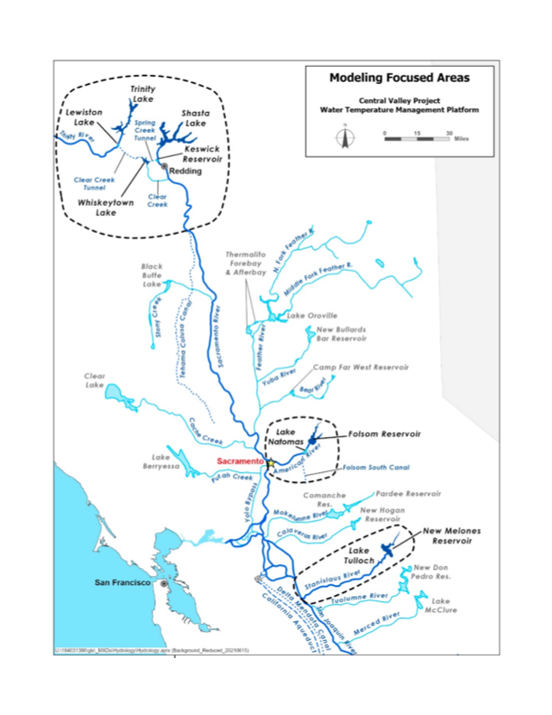
Past and Current Applications of CE-QUAL-W2
CE-QUAL-W2 is widely used by USACE and other federal, state, and local agencies for environmental impact assessments, planning studies, etc. Agencies that use CE-QUAL-W2 as their standard reservoir water quality model include:
U.S. Geological Survey (USGS)
U.S. Bureau of Reclamation (USBR)
U.S. Environmental Protection Agency (EPA)
State of California
More than 1,100 model applications have been developed worldwide for reservoirs, rivers, estuaries, and other water bodies since CE-QUAL-W2 was released in 1986.
CE-QUAL-W2 is also used as a research tool by researchers at universities and other organizations.
At least 1,500 publications utilized or cited CE-QUAL-W2 in the year 2022 alone.
Recent Studies:
Water Temperature Modeling Platform, California Central Valley Project (USBR and State of California): This platform applies CE-QUAL-W2 for ongoing and future operations decision-making
USACE Northwest Division, Columbia and Snake River Watershed
Columbia System Reservoir Operation (CRSO) Project
Columbia River Treaty (CRT) Project
Philadelphia District, Lehigh River Water Quality Modeling
Region of Application:
Water Temperature Modeling Platform
California Central Valley Project

Slide 6
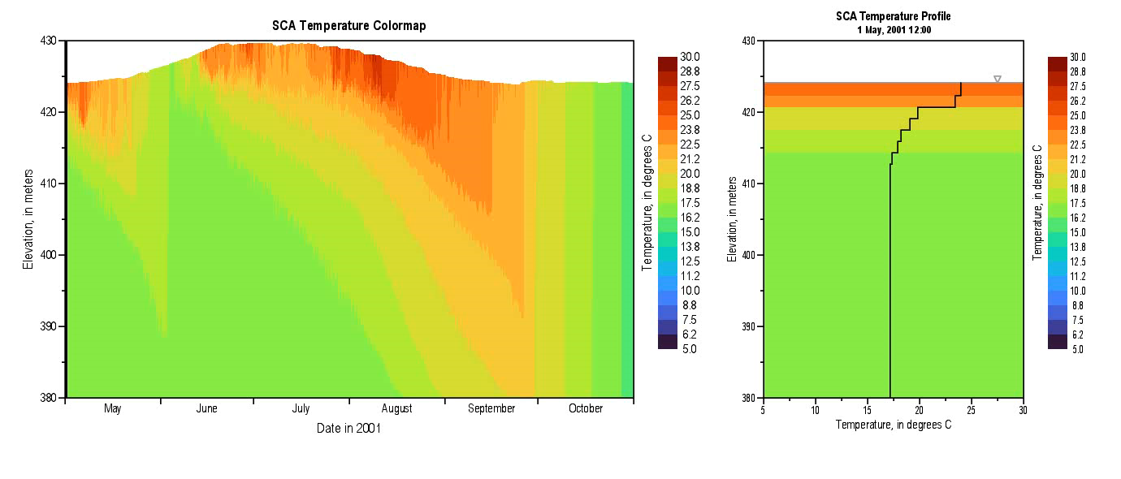
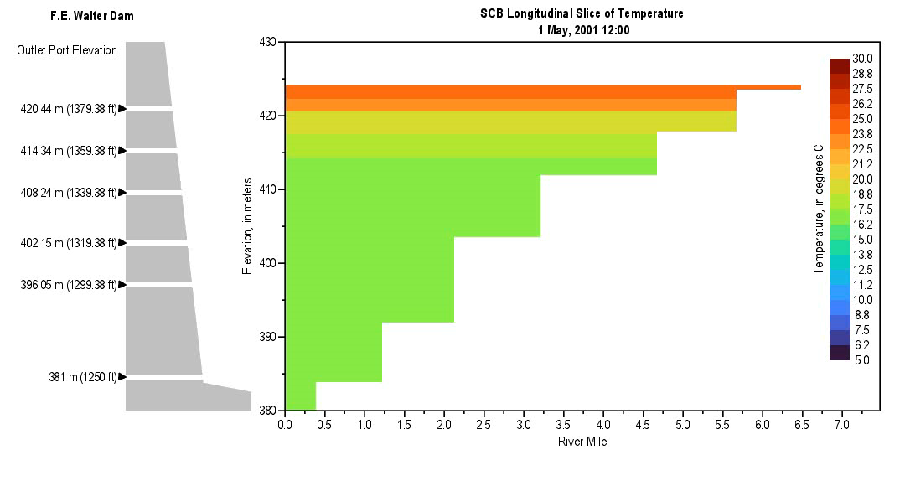
Method and Algorithm Research
Due to excess nutrient loading, warming trends in surface waters, altering hydrologic regimes, and intensifying the stratification of water bodies, Harmful algal blooms (HABs) pose a growing threat to water quality, ecosystem health, and water resource operations.
Four new capabilities were implemented in CE-QUAL-W2 to improve its ability to simulate HABs.
Minimum algae concentration enforcement
Algal treatment regimens:
We focused on mechanical removal of algae (e.g., harvesting)
High algal mortality under hypoxic conditions
Nitrogen fixation by algae.

Slide 7
Survey Results: CE-QUAL-W2 Development Opportunities

Slide 8
Survey Results: CE-QUAL-W2 Development Opportunities

Slide 9
CE-QUAL-W2 Enhancements
Nitrogen fixation to support simulation of cyanobacteria dominance in low-nitrogen conditions. Cyanobacteria may outcompete native algae since they can fix nitrogen.
Minimum algae concentration enforcement to support post-crash recovery.
Hypoxia-induced mortality to reflect algal population dynamics under low oxygen stress.
Mechanical removal (treatments, harvesting) to simulate interventions such as skimming or pumping.
Vertical migration: developing guidance for use.

Slide 10
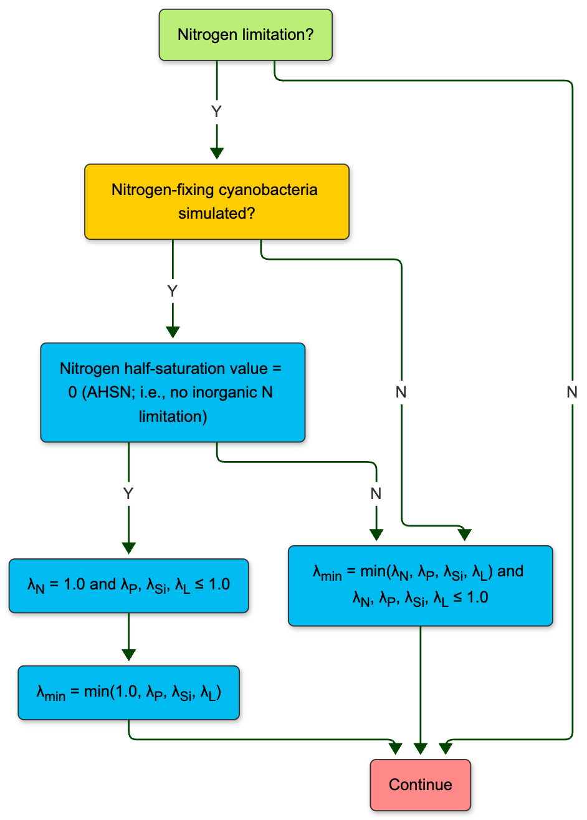
Nitrogen Fixation
Purpose: To simulate atmospheric nitrogen uptake by diazotrophic algae under nitrogen-limited conditions.
Implementation:
Optional activation per algal group, enabled through user input.
Adds a supplementary nitrogen source term when DIN concentrations fall below a user-defined threshold.
Internal logic uses a Monod-like function to modulate fixation rate based on DIN availability.
Ensures conservation of mass and allows continuous algal growth in nitrogen-limited but phosphorus-replete environments.

Slide 11
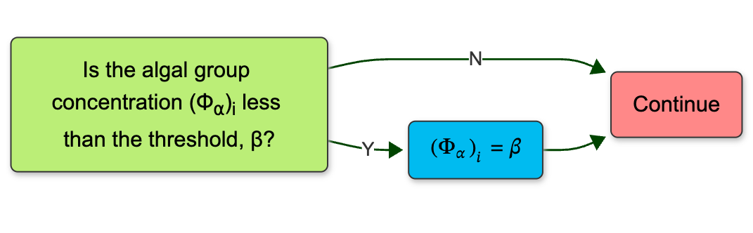
Minimum Algae Concentration
Purpose: To prevent complete depletion of algae due to high mortality events, enabling post-bloom recovery in the absence of boundary-driven reintroduction.
Implementation:
A user-defined floor value for algal biomass is enforced after each time step.
The logic is embedded within the wqconstituents.f90 file and applied across all layers and segments where algal concentrations fall below the minimum.
An optional input parameter allows global or group-specific specification of the threshold.
The minimum value acts as a lower bound; once concentrations fall below it due to mortality or other sinks, they are reset to the threshold for subsequent time steps.

Slide 12
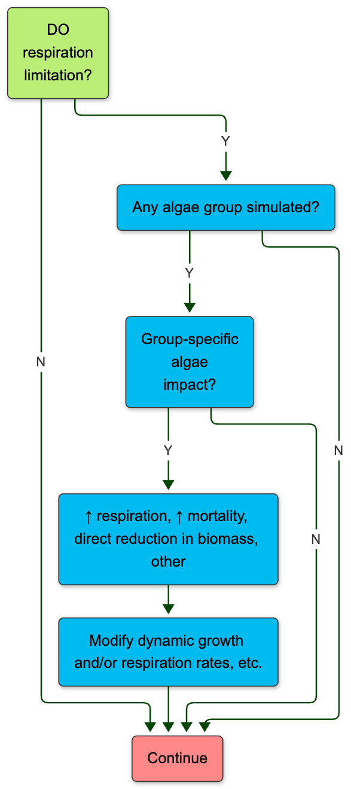
Hypoxia-Induced Mortality
Purpose: To increase algal mortality in response to low dissolved oxygen (DO), reflecting physiological stress and bloom collapse under hypoxic conditions.
Implementation:
Logic added to algal growth and mortality routines to apply increased death rate when DO falls below a user-defined threshold.
Supports multiple response forms: step function, linear scaling, or Monod-style inhibition.
Applies uniformly to all algae in affected segments unless otherwise configured.

Slide 13
Mechanical Removal (Algal Harvesting and Other Treatments)
Purpose: To simulate segment-specific algal biomass removal, reflecting surface skimming, pumping, or other mechanical control actions.
Implementation:
New input file defines the active segments, interpolation method, and time-series file path.
A time-varying file provides fractional reductions by segment and simulation day.
Four modules were modified:
w2modules.f90input.f90, time-varying-data.f90, and wqconstituents.f90.
Removal was implemented as an instantaneous fractional reduction in the algal state variables during the time step corresponding to the input.

Slide 14
Results
Simulation | Value Turned ON | Value of New Input | Plot color
1 | -- Baseline -- | -- Baseline -- | Black
2 | ALG_O2LIM | 1.0 mg/L | Yellow
3 | ALG_MIN | 0.1 mg/L (biomass) | Blue
4 | CRIT_TIN | 1.5 mg/L | Red
5 | No new inputs | See above | Cyan

Slide 15
CE-QUAL-W2: Evaluating Operational Strategies for HAB Management
Hypolimnetic Withdrawal
Surface Flushing
Pulsed Inflows
Quantify P & N mass exported via deep releases
Track thermocline response to withdrawal rates
Determine minimum flow to reduce residence time below bloom threshold
Simulate bloom recovery time after flushing ends
Model plunge depth based on inflow temperature
Evaluate stratification disruption vs. pulse magnitude
Artificial Mixing
Hypolimnetic Aeration
Water Level, Temperature Control
Structures, Harvesting
Test mixing intensity (Kz) to achieve mixing
Compare algal biomass under continuous vs. intermittent mixing
Simulate O₂-dependent sediment P release reduction
Multi-year runs to assess cumulative internal load decrease
Evaluate residence time changes with pool elevation
Specify harvesting rates & locations for biomass removal
Scenario-based evaluation of individual of various control strategies with CE-QUAL-W2 will improve identification of site-specific bloom drivers and development of HAB management plans.

Slide 16

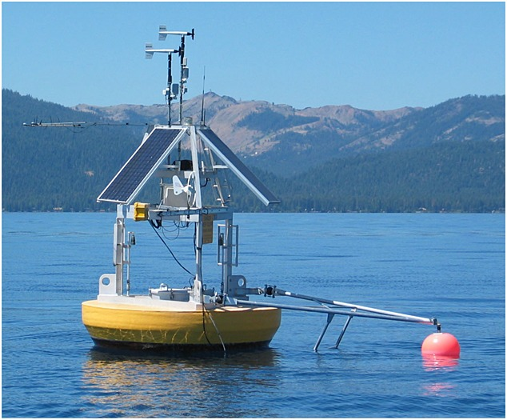
Benefits
CE-QUAL-W2 will:
Simulate HAB occurrences with greater precision.
Improve understanding of how various environmental factors contribute to HAB dynamics, enabling more proactive management.
Provide results that help formulate effective mitigation strategies to reduce the frequency and severity of HAB events by targeting identified key contributing factors.
Facilitate adaptive management practices.
Improve HAB simulation of multiple future scenarios will improve emergency response and sampling.
Provide early detection and management of HABs to protect ecosystem health and public safety, minimizing the adverse effects on wildlife and human populations.

Slide 17

Questions?

